Slide 1
Sensor & Input App
TTS (Text-to-Speech)
Sensors
Standalone GPS
Companion Smartphone GPS

Slide 2
Objective
Become familiar with the following native API basics for wearables:
Text-to-Speech - Synthesize text into sound data as utterance and play, pause, and stop it
Sensor - Manage sensors such as accelerometer, barometer, etc., retrieve information from and about them, and set intervals for sensor events
Location - Retrieve and use location information, and track routes from the GPS
Samsung Accessory Protocol – Communicate between a companion phone and smartwatch
Use the above APIs to build sample native apps

Slide 3
Prerequisites
Operating System – Windows or Linux
Tizen SDK version – 2.4 Rev2 SDK
Target – Samsung Gear S2 or Emulator
Emulator Image – 2.3.1-wearable-circle
Basic familiarity with Tizen application lifecycle and UI components
Note - A compatible Android phone(Kitkat or later) is required for the last app, reading the GPS location from the companion mobile phone on the smartwatch. Android studio and SDK are also needed to build the smartphone android apk for the last app.

Slide 4
TTS (Text-to-Speech)

Slide 5
Structure of the TTS Presentation
Tizen TTS API Features
Overview of TTS Process
Basic Requirements
Online Resources
Steps to make a simple TTS code -
Step 1: Creating the TTS Handle
Step 2: Setting the callbacks
Step 3: Connecting to the TTS Daemon
Step 4: Adding Text
Step 5: Playing Text
Step 6: Stopping TTS
Lifecycle and states of TTS
Screenshots

Slide 6
Tizen TTS API Features
Text-To-Speech(below TTS) API reads sound data transformed by the engine using input texts
Applications can add input-text to queue for reading continuously
Applications can play, pause, and stop sound data synthesized from text
Applications can choose the voice (male, female, child), language as well as reading speed
The TTS API also notifies you (by callback mechanism) when the state of TTS is changed, utterance is started and completed, default voice is changed or an error occurred

Slide 7
Overview of TTS Process
Create a handle and register callback functions.
Create a TTS handle which is used for distinguishing your application from other applications also using the TTS.
To get notifications about state changes, language changes, starting or finishing utterances, and errors, register callback functions.
Add text.
Add the text that you want to read out by the TTS module. The requested text is handled as an utterance. You can add several texts, and they are managed using a queue.
There is a limit on the maximum text length for one utterance, and the time spent for synthesizing is dependent on the text length.
Play, pause, and stop playback.
Synthesize the text in the queue and play the sound data after synthesizing.
You can also pause and stop playing. If you call the function to stop, all requested data (both the sound data and text in the queue) is deleted.

Slide 8
Basic Requirements
We use the native template “Basic UI Application (EDC)” for wearables
To make a new project with this template, go to File -> New -> Tizen Native Project -> Templates -> Wearable 2.3.1 -> Basic UI Application with EDC
Required Header (add to your /inc/<projectmainfile>.h)– #include <tts.h>
Required Feature (add to you tizen-manifest.xml)- http://tizen.org/feature/speech.synthesis

Slide 9
Online Resources
Source Code - All of the source code used below for TTS can be found at - https://developer.tizen.org/community/code-snippet/native-code-snippet/simple-text-speech-application-wearable
API Reference - The API reference for TTS can be found at - https://developer.tizen.org/dev-guide/2.3.1/org.tizen.native.wearable.apireference/group__CAPI__UIX__TTS__MODULE.html
Tutorial - A tutorial for using TTS on Tizen can be found at - https://developer.tizen.org/development/tutorials/native-application/uix/tts
Guide - A guide on using TTS on Tizen can be found at - https://developer.tizen.org/dev-guide/latest/org.tizen.guides/html/native/uix/tts_n.htm

Slide 10
Step 1: Creating the TTS Handle
Add a tts handle variable to the struct appdata_s–
Create a integer variable to hold the return values of the functions. All TTS functions return TTS_ERROR_NONE if the function is successful, or corresponding other values from enum tts_error_e (declared in <tts.h>) if there was some error –
Create a TTS handle. The TTS handle is used for other TTS functions as a parameter. When the function return successfully, TTS state changes to TTS_STATE_CREATED. Here, ad is a pointer of type appdata_s –
tts_h tts;
int ret;
ret = tts_create(&(ad->tts));
//Error handling depending on value of ret

Slide 11
Step 2: Setting the callbacks
Create a callback function state_changed_cb and set it. If you set the state change callback for the TTS, it is invoked when the TTS state changes. We will cover the details of state_changed_cb in the next few slides.
void state_changed_cb(tts_h tts, tts_state_e previous, tts_state_e current, void* user_data) {
/* We shall come to this code in the next few slides */
}
/* set the state change callback for the TTS. It is invoked when the TTS state changes */
ret = tts_set_state_changed_cb(ad->tts, state_changed_cb, ad);
//Error handling depending on value of ret

Slide 12
Step 2: Setting the callbacks
Create a callback function utterance_completed_cb for when the TTS finishes speaking and set it.
void utterance_completed_cb(tts_h tts, int utt_id, void* user_data) {
appdata_s *ad = (appdata_s *) user_data;
//for setting the text to display
elm_object_text_set(ad->label, "Text-To-Speech completed successfully");
}
/* set the utterance completed callback for the TTS. It is invoked when text synthesized by the TTS engine finishes playing */
ret = tts_set_utterance_completed_cb(ad->tts, utterance_completed_cb, ad);
//Error handling depending on value of ret

Slide 13
Step 3: Connecting to the TTS Daemon
Connect to the background TTS daemon. The daemon synthesizes the text with the engine and plays the resulting sound data –
When tts_prepare finishes, TTS state changes to TTS_STATE_READY from TTS_STATE_CREATED . The function is asynchronous, however when the state changes state_changed_cb is called.
/*
* After you create the TTS handle, connect to the background TTS daemon.
* The tts_prepare() function is asynchronous.
* The state of the TTS is changes to TTS_STATE_READY when tts_prepare() finishes.
*/
ret = tts_prepare(ad->tts);
//Error handling depending on value of ret
/* Callback for whenever TTS changes state */
void state_changed_cb(tts_h tts, tts_state_e previous, tts_state_e current, void* user_data) {
/* Current state is READY and previous state is CREATED implies TTS is prepared */
if (TTS_STATE_READY == current && TTS_STATE_CREATED == previous) {
/* Add Text and play – In the next slide */
}
}

Slide 14
Step 4: Adding Text
Use the below code when TTS is ready to add text to play –
You can also adjust the language, voice-type, reading speed by adjusting the above parameters. See the API doc for details.
appdata_s *ad = (appdata_s *) user_data;
int ret;
const char* text =
"This is a simple text-to-speech Application. "
"The text-to-speech features include synthesizing text "
"into sound data as utterances and playing them. "
"It is also possible to pause and stop playing. "; // Text to read
const char* language = "en_US"; // Language
int voice_type = TTS_VOICE_TYPE_FEMALE; // Voice type
int speed = TTS_SPEED_AUTO; // Read speed
int utt_id; // Utterance ID for the requested text
/*
* Add the text to speak to TTS
* Needs the current state to be Ready, Playing or Paused
*/
ret = tts_add_text(ad->tts, text, language, voice_type, speed, &utt_id);
//Error handling depending on value of ret

Slide 15
Step 5: Playing Text
After adding text to TTS, you can start playing it –
/*
* Start playing TTS (speaking)
* Needs the current state to be Ready or Paused
*/
ret = tts_play(ad->tts);
//Error handling depending on value of ret
elm_object_text_set(ad->label, "Started playing Text-to-Speech");
dlog_print(DLOG_INFO, LOG_TAG, "Added text and started playing");

Slide 16
Step 6: Stopping TTS
To stop the playback at anytime use tts_stop –
When you are done with TTS, call tts_unprepare –
Unset the callback for state changed –
/*
* To stop the playback, use the tts_stop() function.
* All the texts in the queue are removed.
* The state is changed to TTS_STATE_READY.
*/
ret = tts_stop(ad->tts);
//Error handling depending on value of ret
/* The tts_unprepare() function is used for disconnection from the TTS daemon */
ret = tts_unprepare(ad->tts);
//Error handling depending on value of ret
/* Unset the callback for state changed */
ret = tts_unset_state_changed_cb(ad->tts);
//Error handling depending on value of ret

Slide 17
Step 6: Stopping TTS
Unset the callback for utterance completed –
Destroy the TTS handle using tts_destroy -
/* Unset the callback for utterance completed */
ret = tts_unset_utterance_completed_cb(ad->tts);
//Error handling depending on value of ret
/*
* When TTS library is no longer needed, destroy the TTS handle using the tts_destroy()
*
* Do not use the tts_destroy() function within the callback function,
* or the tts_destroy() function fails and returns TTS_ERROR_OPERATION_FAILED.
*/
ret = tts_destroy(ad->tts);
//Error handling depending on value of ret

Slide 18
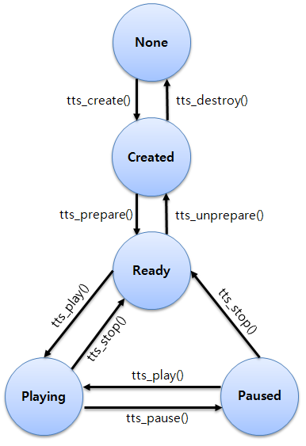
Lifecycle and State of TTS

Slide 19
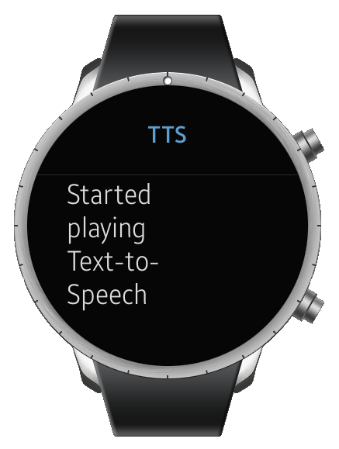
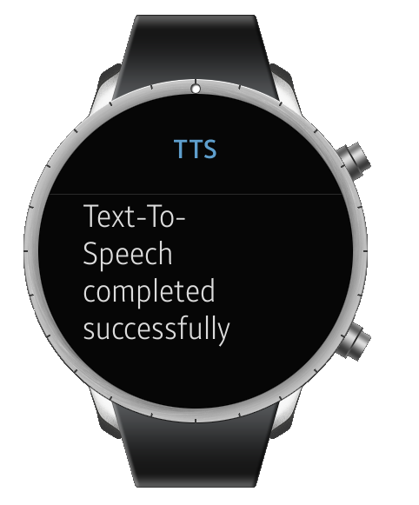
Screenshots

Slide 20
SENSORS

Slide 21
Structure of the Sensors Presentation
Tizen Sensors API Features
Overview of Sensors Process
Basic Requirements
List of Available Sensors
Online Resources
Steps to make a simple TTS code -
Step 1: Create a sensor type
Step 2: Check Support and create handle
Step 3: Create a Listener
Step 4: Read Data
(Optional) Step 5: Detect Sensor Events
Step 6: Destroying the Listener and Handle

Slide 22
Tizen Sensors API Features
The Sensor API detects sensors and monitors their availability. The key sensor listening features provided by the Sensor API include:
Adding and removing sensor listeners
Checking available sensors
Getting sensor data
Sensor listeners can be added or removed at any time.
Listeners receive registered sensor events and deliver the event data to applications at predefined intervals.
The applications can add multiple sensor listeners for the same sensor type.

Slide 23
Overview of Sensor Process
Check support for the sensor and retrieve the handle
Check if the specific sensor is available on the current device
Retrieve a handle to a the sensor of the required type
Create a sensor listener and register callbacks
Create a sensor listener which is an event listener used to receive sensor data asynchronously.
Optional - Register callbacks for when sensor event occurs (i.e., sensor values change)
Start the listener and read data
Before data can be read or callbacks invoked, the listener need to be started
Read sensor data directly, or wait for callback from sensor event

Slide 24
Basic Requirements
We use the native template “Basic UI Application (EDC)” for wearables
To make a new project with this template, go to File -> New -> Tizen Native Project -> Templates -> Wearable 2.3.1 -> Basic UI Application with EDC
Required Header (add to your /inc/<projectmainfile>.h) – #include <sensor.h>
Required Feature (add to you tizen-manifest.xml) – See next slide
Required Privilege (add to you tizen-manifest.xml) – Only for using Heart Rate Monitor sensors : http://tizen.org/privilege/healthinfo

Slide 25
List of Sensors in Tizen
Note that not all sensors are available on all devices

Slide 26
Online Resources
Source Code - All of the source code used below for Sensors can be found at – https://developer.tizen.org/community/code-snippet/native-code-snippet/simple-sensors-application-wearable
API Reference - The API reference for Sensors can be found at - https://developer.tizen.org/dev-guide/2.3.1/org.tizen.native.wearable.apireference/group__CAPI__SYSTEM__SENSOR__MODULE.html
Tutorial - A tutorial for using Sensors on Tizen can be found at - https://developer.tizen.org/development/tutorials/native-application/system/sensor
Guide - A guide on using Sensors on Tizen can be found at - https://developer.tizen.org/dev-guide/latest/org.tizen.tutorials/html/native/system/sensor_tutorial_n.htm

Slide 27
Step 1: Create a Sensor Type
Add a sensor listener variable and a sensor type enum to the struct appdata_s–
Create a integer variable to hold the return values of the functions. All TTS functions return SENSOR_ERROR_NONE if the function is successful, or corresponding other values from enum sensor_error_e (declared in <sensor.h>) if there was some error –
Create a sensor_type_e variable to select the required sensor. The possible values taken by enum enum sensor_error_e are declared in <sensor.h> , and also listed in the table above -
sensor_listener_h tts;
sensor_type_e type;
int ret;
ad->type = SENSOR_ACCELEROMETER;

Slide 28
Step 2: Check Support and Create Handle
Check whether a sensor is supported on the given device –
Get a handle to the sensor, needed to call other functions –
bool supported;
ret = sensor_is_supported(ad->type, &supported);
//Error handling depending on value of ret
/* If supported is false, sensor is not supported. Return. */
if (supported == false) {
dlog_print(DLOG_INFO, LOG_TAG, "sensor is not supported");
elm_object_text_set(ad->label,
"Sensor is not available on this device<br/><br/>");
return;
}
/* Get a handle of the default sensor */
sensor_h sensor;
ret = sensor_get_default_sensor(ad->type, &sensor);
//Error handling depending on value of ret

Slide 29
Step3 : Create a Listener
Create a sensor listener to receive sensor data asynchronously –
Set options to keep sensors always on -
Start the listener to begin receiving data -
/*
* Create a sensor listener.
* This listener is an event listener used to receive sensor data asynchronously.
*/
ret = sensor_create_listener(sensor, &(ad->listener));
//Error handling depending on value of ret
/*
* Change the sensor to be always-on.
* By default sensor data cannot be received when the LCD is off and in the power save mode.
*/
ret = sensor_listener_set_option((ad->listener), SENSOR_OPTION_ALWAYS_ON);
//Error handling depending on value of ret
/*
* Starts the sensor server for the given listener.
* After this function is called, sensor events will occur and the specific sensor type
* related callback function will be called. An application can read sensor data.
*/
ret = sensor_listener_start((ad->listener));
//Error handling depending on value of ret

Slide 30
Step 4: Read Data
Use the listener to read data. The data will be contained in a struct of type sensor_event_s -
And example way to display the data -
/* Read sensor data */
sensor_event_s event;
ret = sensor_listener_read_data((ad->listener), &event);
//Error handling depending on value of ret
/* Display the data read. The number of values returned by the sensor is event.value_count */
if (SENSOR_ERROR_NONE == ret) {
dlog_print(DLOG_INFO, LOG_TAG, "sensor data read successfully");
char buf[1024];
char tempbuf[1024];
snprintf(buf, 1023, "Sensor data read successfully.<br/>");
for (int i = 0; i<event.value_count;i++){
snprintf(tempbuf, 1023, "Sensor value[%d] is - %f<br/>",i,event.values[i]);
strcat(buf, tempbuf);
}
snprintf(tempbuf, 1023, "Sensor timestamp is - %llu<br/>",event.timestamp);
strcat(buf, tempbuf);
snprintf(tempbuf, 1023, "Sensor accuracy is - %d<br/>",event.accuracy);
strcat(buf, tempbuf);
elm_object_text_set(ad->label, buf);
// Use sensor information
}

Slide 31
Step 5: Detecting Sensor Events
Create a sensor callback function –
Register the callback function for the listener –
void on_sensor_event(sensor_h sensor, sensor_event_s *event, void *data) {
appdata_s *ad = data;
// This example uses sensor type, assuming there is only 1 sensor for each type
sensor_type_e type;
sensor_get_type(sensor, &type);
//Check the sensor type of the sensor event
if(type == (ad->type)){
// Use sensor information
}
}
/* Register a callback if a sensor event is detected (sensor value changed) */
ret = sensor_listener_set_event_cb((ad->listener), 100, on_sensor_event,
ad);
//Error handling depending on value of ret

Slide 32
Step 6: Destroying the Listener
Unregister callbacks -
Stop the listener –
Destroy the handle –
/* Unset the callback for when a sensor event is detected */
ret = sensor_listener_unset_event_cb((ad->listener));
//Error handling depending on value of ret
/* Stops the sensor server for the given listener. */
ret = sensor_listener_stop((ad->listener));
//Error handling depending on value of ret
/* Destroys the sensor handle and releases all its resources. */
ret = sensor_destroy_listener((ad->listener));
//Error handling depending on value of ret

Slide 33
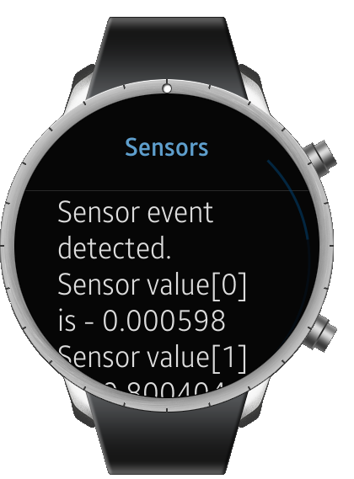
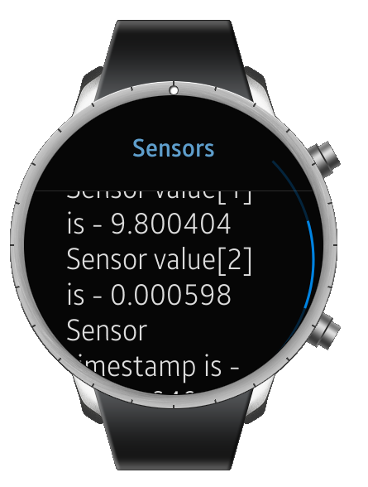
Screenshots

Slide 34
STANDALONE GPS

Slide 35
Structure of the GPS Presentation
Tizen Locations API Features
Overview of GPS Process
Basic Requirements
Online Resources
Steps to make a simple GPS code -
Step 1: Create location manager handle
Step 2: Set callbacks and start location manger
Step 3: Read location data
Step 4: Destroy the handle
Screenshots

Slide 36
Tizen Location API Features
The Location Manager API provides functions to acquire information about geographical location, including both as accurate a current position as possible, and receiving notification of changes in position, crossing boundary "fences", and velocity changes detected by the device.
Notifications can be received about the following events:
Change in service status (enabled / disabled)
New position and velocity information becoming available
Given area being entered or left (geo-fencing)
A location manager serves as a gateway so the application does not have to manage the details of the back-end connection, which might be GPS, Wi-Fi or others, although it may instruct the location manager as to a preference.

Slide 37
Overview of Location Process
Retrieve a handle on the location manager and set callbacks
Retrieve a location manager
Register a callback function for when service state changes
Receive callback and read location data
Upon receiving callback, check if the location service is enabled
Read location data once the service is enabled

Slide 38
Basic Requirements
We use the native template “Basic UI Application (EDC)” for wearables
To make a new project with this template, go to File -> New -> Tizen Native Project -> Templates -> Wearable 2.3.1 -> Basic UI Application with EDC
Required Header (add to your /inc/<projectmainfile>.h) – #include <locations.h>
Required Features (add to you tizen-manifest.xml) –
http://tizen.org/feature/location
http://tizen.org/feature/location.gps
http://tizen.org/feature/location.wps
Required Privilege (add to you tizen-manifest.xml) – Only for using Heart Rate Monitor sensors - http://tizen.org/privilege/location

Slide 39
Online Resources
Source Code - All of the source code used below for Locations can be found at – https://developer.tizen.org/community/code-snippet/native-code-snippet/simple-standalone-gps-application-wearable
API Reference - The API reference for Location can be found at - https://developer.tizen.org/dev-guide/2.3.1/org.tizen.native.wearable.apireference/group__CAPI__LOCATION__MANAGER__MODULE.html
Tutorial - A tutorial for using Locations on Tizen can be found at - https://developer.tizen.org/development/tutorials/native-application/location/location-manager
Guide - A guide on using Locations on Tizen can be found at - https://developer.tizen.org/dev-guide/latest/org.tizen.guides/html/native/location/location_n.htm

Slide 40
Step 1: Create a Location Manager Handle
Add a location manager handle variable to the struct appdata_s–
Create a integer variable to hold the return values of the functions. All TTS functions return LOCATIONS_ERROR_NONE if the function is successful, or corresponding other values from enum location_error_e (declared in <locations.h>) if there was some error –
Create a location manager handle. The sources of the location data are defined in enum location_method_e, including LOCATIONS_METHOD_WPS or LOCATIONS_METHOD_GPS. A location manager set to the hybrid method will automatically choose the best method available at the moment, choosing between GPS, WPS –
location_manager_h manager;
int ret;
/* Create a location manager handle */
ret = location_manager_create(LOCATIONS_METHOD_HYBRID, &(ad->manager));

Slide 41
Step 2: Set Callbacks and Start Location Manager
Create a callback function for when the location service state changes -
Register the callback function with the location manager –
Start the location manager –
void standalone_gps_state_changed_cb(location_service_state_e state,
void *user_data) {
//We will come to the details of this function in the next slides
}
/* Register a callback function for location service state changes */
ret = location_manager_set_service_state_changed_cb(ad->manager,
standalone_gps_state_changed_cb, ad);
/* Start the Location Manager */
ret = location_manager_start(ad->manager);

Slide 42
Step3 : Read Location Data
In the callback for service state changed, check if the current location service state is LOCATIONS_SERVICE_ENABLED and read data –
/* Callback for whenever GPS state is changed */
void standalone_gps_state_changed_cb(location_service_state_e state,
void *user_data) {
int ret;
/* Check if the service is enabled */
if (LOCATIONS_SERVICE_ENABLED == state) {
appdata_s* ad = user_data;
elm_object_text_set(ad->label,
"GPS Location service started. Waiting for location.<br/><br/>");
//Receive the current information about position, velocity,
// or location accuracy:
double altitude, latitude, longitude;
time_t timestamp;
int ret = location_manager_get_position(ad->manager, &altitude, &latitude, &longitude, &timestamp);
if (LOCATIONS_ERROR_NONE == ret) {
//Process the location information
}
}
}

Slide 43
Sample Code to Display the Location Data
/* Sample code to display the data */
dlog_print(DLOG_INFO, LOG_TAG,
"location got altitude %f, latitude %f, longitude %f",
altitude, latitude, longitude);
char buf[1024];
char* timebuf;
timebuf = asctime(localtime(&timestamp));
snprintf(buf, 1023,
"GPS Location Acquired.<br/>"
"Altitude is - %f <br/>"
"Latitude is - %f <br/>"
"Longitude is - %f <br/>"
"Timestamp is - %s <br/><br/>",
altitude, latitude, longitude, timebuf);
elm_object_text_set(ad->label, buf);

Slide 44
Step 4: Destroying the Handle
Destroy all used resources when no longer needed using location_manager_destroy() -
/* Function which handles all the work of unsetting and stopping the location manager */
void exit_gps(appdata_s *ad) {
/*
* At the end of the application, destroy all used resources, such as the location manager
* If you destroy the handle, there is no need to call the location_manager_stop() function to stop the service.
* The service is automatically stopped. Also, you do not have to unset previously set callbacks.
*/
location_manager_destroy(ad->manager);
ad->manager = NULL;
}

Slide 45
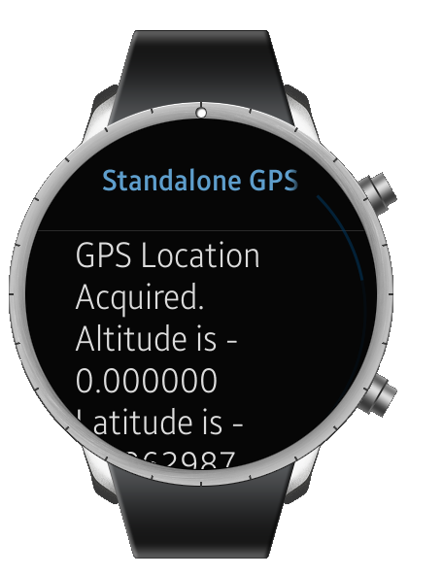
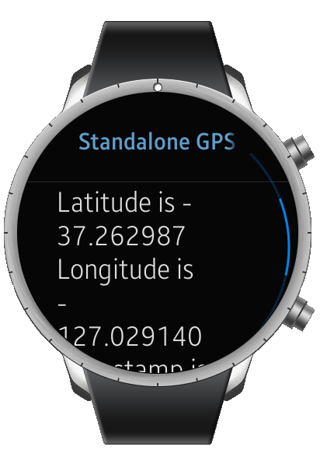
Screenshots

Slide 46
COMPANION SMARTPHONE GPS

Slide 47
Structure of the Companion GPS Presentation
Overview of Companion GPS Process
Basic Requirements
Online Resources
Steps to make a simple Companion GPS code -
Step 1: Create an class for Managing Location
Step 2: Create a Location Listener
Step 3: Read Location Data
Step 4: Request Location Updates
Step 5: Send the Location to Wearable
Screenshots
Appendix
Using Gear Emulator with Android Device
Basics of SAP

Slide 48
Overview of Location Process
This application is more advanced than previous ones as communication between two devices is required –
Establish a connection between the wearable (“consumer”) and the companion smartphone host (“provider”)
Use Samsung Accessory Protocol (SAP) to connect smartphone and wearable
The smartphone must be a supported one, and have gear manager installed. It must also be paired with the smartwatch.
Use Android APIs to fetch location data from smartphone
Send the location data to the wearable
Samsung Accessory Protocol is again used to send the data

Slide 49
Basic Requirements
Supported Android host Smartphone with gear manager installed
The gear manager is available at http://apps.samsung.com/gear
System Requirements for gear manager – Android version 4.4 (KitKat) or higher, 1.5GB memory or higher, WVGA or higher screen resolution
We use the native sample application for using the Samsung Accessory Protocol “Gear | Companion Type - Hello Accessory(Native)” available at http://developer.samsung.com/sample-app/view.do?v=S000000086D
From the above sample, we use the apps Provider Android and Consumer Tizen App
Note - The Consumer Tizen app is for an older version of the SDK In order to build it for SDK 2.4, simply make a new project in SDK 2.4 and copy all the relevant source files from the Consumer Tizen app to the new project. Make sure to have Tizen extension SDK installed, otherwise building will result in the error “sap.h not found”

Slide 50
Online Resources
SAP API Reference - The API reference for Samsung Accessory Services can be found at - http://img-developer.samsung.com/onlinedocs/sms/accessory/index.html
Native Guide - A guide on using Accessory Service from Tizen native can be found at - http://developer.samsung.com/technical-doc/view.do?v=T000000239&pi=1&ps=10&pb=Y&ct=CT030000&sc=
Full Guide - A full general guide for using Accessory Service on Tizen can be found at - http://developer.samsung.com/technical-doc/view.do?v=T000000237&pi=1&ps=10&pb=Y&ct=CT030000&sc=
Location Manager API Reference - The API reference for Location Manager on Android can be found at - http://developer.android.com/reference/android/location/LocationManager.html
Guide for using Emulator - A guide for using the Gear emulator with Android smartphone host is available at - http://developer.samsung.com/technical-doc/view.do?v=T000000162

Slide 51
Step 1: Create an class for Managing Location
Create an abstract class to hold the location result and take an action once the location is received –
class MyLocation {
Timer timer1;
LocationManager lm;
LocationResult locationResult;
boolean gps_enabled=false;
boolean network_enabled=false;
public boolean getLocation(Context context, LocationResult result){
//To be defined later
}
LocationListener locationListenerGps = new LocationListener() {
//To be defined later
};
LocationListener locationListenerNetwork = new LocationListener() {
//To be defined later
};
class GetLastLocation extends TimerTask {
//To be defined later
}
public static abstract class LocationResult{
public abstract void gotLocation(Location location);
//To be defined later
}
}

Slide 52
Step 2: Create a Location Listener
Create a Location Listener to listen to GPS –
Create a Location Listener to listen to Network Location –
LocationListener locationListenerGps = new LocationListener() {
public void onLocatiON-CHANGEd(Location location) {
timer1.cancel();
locationResult.gotLocation(location);
lm.removeUpdates(this);
lm.removeUpdates(locationListenerNetwork);
}
public void onProviderDisabled(String provider) {}
public void onProviderEnabled(String provider) {}
public void onStatusChanged(String provider, int status, Bundle extras) {}
};
LocationListener locationListenerNetwork = new LocationListener() {
public void onLocatiON-CHANGEd(Location location) {
timer1.cancel();
locationResult.gotLocation(location);
lm.removeUpdates(this);
lm.removeUpdates(locationListenerGps);
}
public void onProviderDisabled(String provider) {}
public void onProviderEnabled(String provider) {}
public void onStatusChanged(String provider, int status, Bundle extras) {}
};

Slide 53
Step3 : Read Location Data
Read the last known location using the Location Manager –
class GetLastLocation extends TimerTask {
@Override
public void run() {
lm.removeUpdates(locationListenerGps);
lm.removeUpdates(locationListenerNetwork);
Location net_loc=null, gps_loc=null;
if(gps_enabled)
gps_loc=lm.getLastKnownLocation(LocationManager.GPS_PROVIDER);
if(network_enabled)
net_loc=lm.getLastKnownLocation(LocationManager.NETWORK_PROVIDER);
//if there are both values use the latest one
if(gps_loc!=null && net_loc!=null){
if(gps_loc.getTime()>net_loc.getTime())
locationResult.gotLocation(gps_loc);
else
locationResult.gotLocation(net_loc);
return;
}
if(gps_loc!=null){
locationResult.gotLocation(gps_loc);
return;
}
if(net_loc!=null){
locationResult.gotLocation(net_loc);
return;
}
locationResult.gotLocation(null);
}
}

Slide 54
Step 4: Request Location Updates
Request updates to the location -
public boolean getLocation(Context context, LocationResult result)
{
//Use LocationResult callback class to pass location value from MyLocation to user code.
locationResult=result;
if(lm==null)
lm = (LocationManager) context.getSystemService(Context.LOCATION_SERVICE);
//exceptions will be thrown if provider is not permitted.
try{gps_enabled=lm.isProviderEnabled(LocationManager.GPS_PROVIDER);}catch(Exception ex){}
try{network_enabled=lm.isProviderEnabled(LocationManager.NETWORK_PROVIDER);}catch(Exception ex){}
//don't start listeners if no provider is enabled
if(!gps_enabled && !network_enabled)
return false;
if(gps_enabled)
lm.requestLocationUpdates(LocationManager.GPS_PROVIDER, 0, 0, locationListenerGps);
if(network_enabled)
lm.requestLocationUpdates(LocationManager.NETWORK_PROVIDER, 0, 0, locationListenerNetwork);
timer1=new Timer();
timer1.schedule(new GetLastLocation(), 20000);
return true;
}

Slide 55
Step 5: Send the Location to Wearable
Modify the function void onReceive(int channelId, byte[] data) of the class ProviderService to send location instead of time -
@Override
public void onReceive(int channelId, byte[] data) {
if (mConnectionHandler == null) {
return;
}
MyLocation.LocationResult locationResult = new MyLocation.LocationResult(){
@Override
public void gotLocation(final Location location){
new Thread(new Runnable() {
public void run() {
try {
mConnectionHandler.send(HELLOACCESSORY_CHANNEL_ID, location.toString().getBytes());
} catch (IOException e) {
e.printStackTrace();
}
}
}).start();
}
};
MyLocation myLocation = new MyLocation();
myLocation.getLocation(getApplicationContext(), locationResult);
}

Slide 56
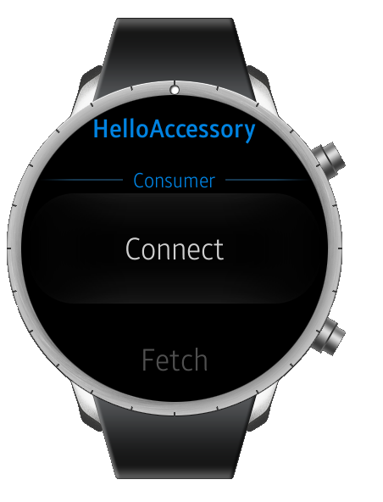
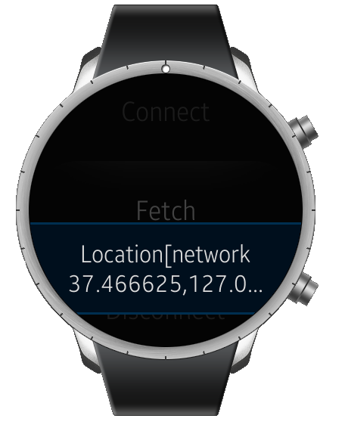
Screenshots

Slide 57
Thank You!

Slide 58
APPENDIX 1
USING GEAR EMULATOR WITH ANDROID HOST

Slide 59
USING GEAR EMULATOR WITH ANDROID HOST
Prior to trying the connection, make sure the following are ready –
Installing the Android Debug Bridge (ADB)
setting up the path of ADB into System Variables (Path) for utilizing it in command window
Installing the GEAR IDE with Tizen Extensions SDK
Download and install Samsung GEAR Manager into your Smart device. (Available at http://apps.samsung.com/gear)
After that download the file Applications_for_Emulator.zip from http://developer.samsung.com/technical-doc/view.do?v=T000000162
After extracting zipped file, you can find the following files: SAAccessoryService_Emul.apk and SASystemProviders_Emul.apk. And then install those to Smart device. –
After installing those files is done, reboot the Smart device and then run Emulator for Samsung Accessory application.
adb install –r SAccessoryServcie_Emul.apk
adb install –r SASystemProviders_Emul.apk

Slide 60
USING GEAR EMULATOR WITH ANDROID HOST
Connect the Smart device and PC via USB.
Open the terminal (or the command window in Windows®).
Execute the command below:
Run Emulator for Samsung Accessory application in the Smart device.
Turn on Wi-Fi or Mobile Network of Smart device
In the Tizen SDK, run the Emulator Manager and create a new virtual machine.
Run the virtual machine of GEAR IDE. The application’s ‘Disconnected’ text should change to ‘Connected’, showing that the connection through the SAP server has succeeded. If the ‘Disconnected’ text does not change, restart the emulator with the hardware key or the sdb shell command below (DO NOT use the sdb shell command reboot)
adb –d forward tcp:8230 tcp:8230
shutdown –r now

Slide 61
APPENDIX 2
Creating the Hello Accessory App

Slide 62
Introduction
Hello Accessory is a pseudo code example to show how to:
Initialize Accessory.
Connect with the remote Accessory Peer Agent.
Send and receive JSON messages between Accessory Peer Agents.
Source code can be downloaded from - http://developer.samsung.com/sample-app/view.do?v=S000000086D
For a Detailed guide into using SAP, see http://developer.samsung.com/technical-doc/view.do?v=T000000136&pi=1&ps=10&pb=Y&ct=CT010100&sc
Hello Accessory is composed of two parts: Consumer and Provider.
Consumer application
Initiates service connection request and sends command to Service Provider.
Shows a received response to user.
Provider application
Accepts a receiving a service connection request from Service Consumer.
Replies to a receiving command from Service Consumer with current time stamp.

Slide 63
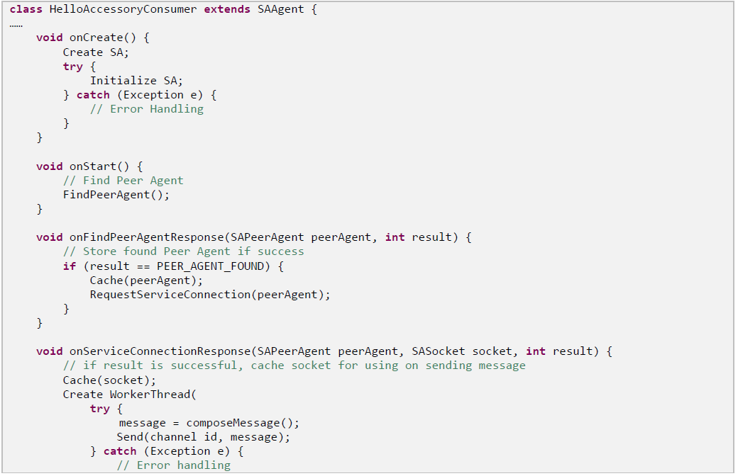
Consumer Application Pseudocode

Slide 64
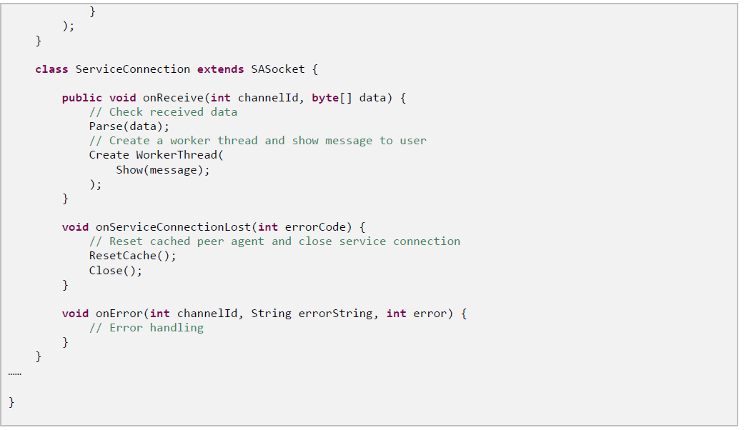
Consumer Application Pseudocode

Slide 65
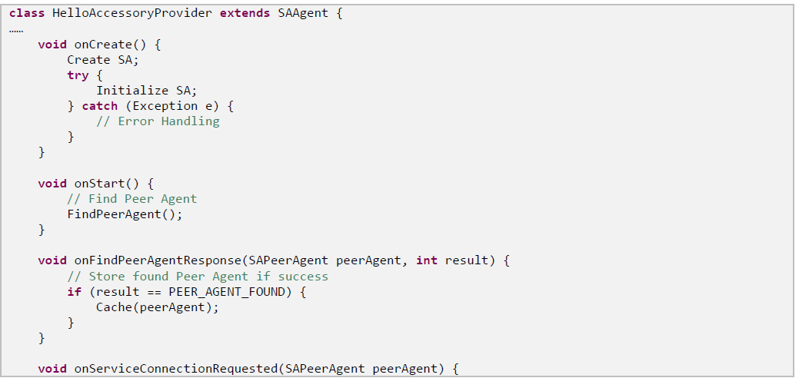
Provider Application Pseudocode

Slide 66
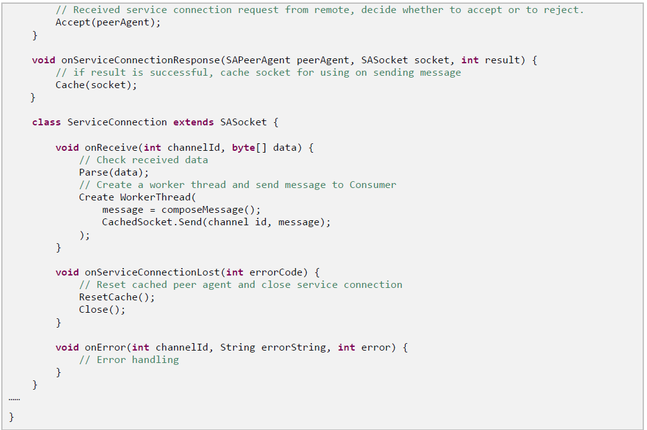
Provider Application Pseudocode

